Slide 1
Combining Probability-Based Rankers for Action-Item Detection
Paul N. Bennett
Microsoft Research
Jaime G. Carbonell
Carnegie Mellon, LTI
HLT/NAACL 2007
April 24, 2007
Copyright © 2007 Paul N. Bennett, Microsoft Corporation

Slide 2
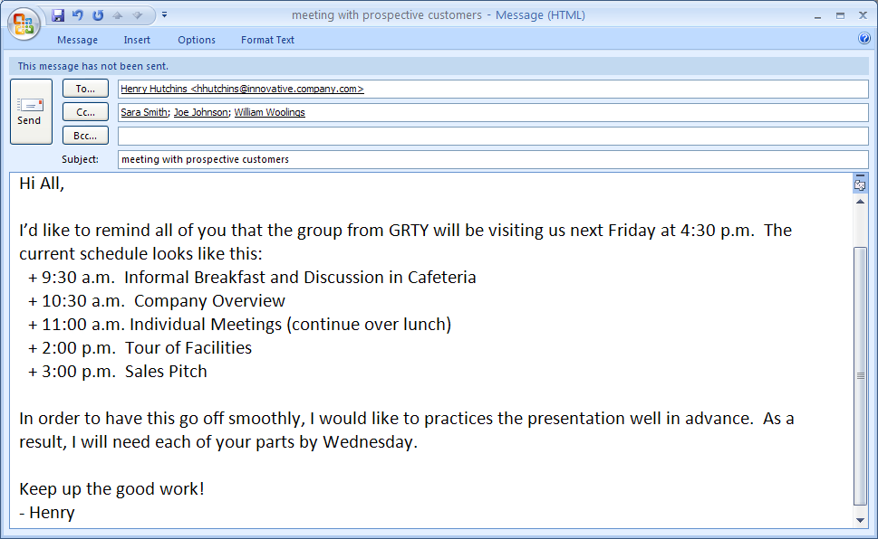
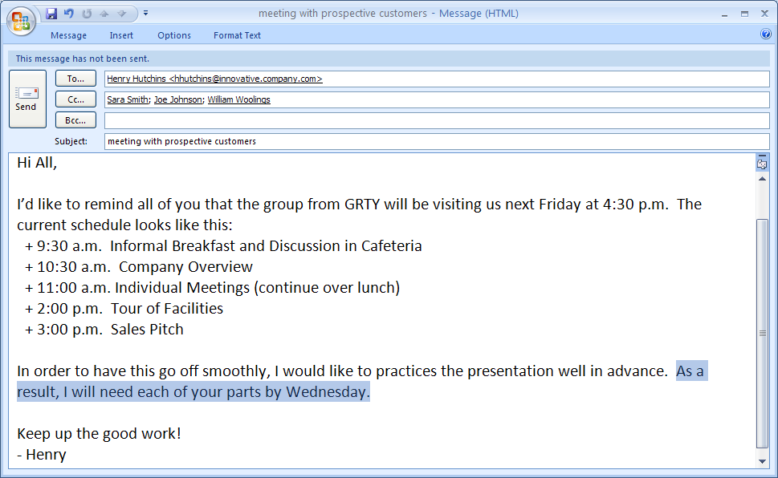
Action Items
Action-Item: An explicit request for information that requires the recipient's attention or action.

Slide 3
Problem Motivation
Many users have limited time and more e-mail than they can process efficiently and accurately.
  Especially important during crunch times or crises.
  Some e-mails have a greater response urgency than others.
  Those that have action-items are more likely to be urgent.
Action-Item Detection is one part of a comprehensive system including spam detection, prioritization, time management, etc.

Slide 4
Primary Tasks
Document detection: Classify a document as to whether or not it contains an action-item.
Document ranking: Rank the documents such that all documents containing action-items occur as high as possible in the ranking.
Sentence detection: Classify each sentence in a document as to whether or not it is an action-item.

Slide 5
Standard vs Fine-Grained Text Classification
Document-level Instances
  Treat each document as an instance.
Sentence-level Instances
  Treat each (automatically-segmented) sentence as an instance.
  Make document-level predictions using sentence-level predictions. Most basic is “Predict document in action-item class if it contains a sentence predicted to be an action-item.”

Slide 6
Representation and View Differences from Other Classification Tasks
Unlike topic classification, key words at the document level don’t really capture the major semantics. Whether or not “could” and “you” occur in a document is relatively uninformative.
For this reason, n-grams are more effective at both levels.
Other features such as end-of-sentence terminators and position in document have a high impact as well.
Fine-grained judgments can be used by a sentence-level classifier to predict with high accuracy in this task.

Slide 7
Different Views Focus on Different Features
Document-Level tends to use features that indicate messages that come from people or organizations that have an extremely high/low number of action-items: “org”, “com”, “edu”, “joe”, “sue”.
  These features are very corpus-specific but can work well at times.
  The n-grams significantly impact the document-level approach.
Sentence-level selects words that are more relevant to the task regardless of the corpus.
  At the document-level, these words can be common in most documents though: “could”, “you”, “UPS”, “send”.
  N-grams make less impact at sentence-level because we already have window.

Slide 8
What approach should we use?
Document-level view or Sentence-level?
n-gram or bag-of-words?
Algorithm: naïve Bayes (multinomial or multivariate Bernoulli), dependency networks, linear SVMs, kNN?
Let’s just use them all and combine them!

Slide 9
Metaclassifiers
STRIVE: Stacked Reliability
Indicator Variable Ensemble
Stacking (Wolpert, 1992)
Metaclassifier
w₁
r₁
w₂
Base Classifiers
w₃
Reliability
Indicators
r₂
…
…
w_{n}
r_{n}
c
c
Nested cross-validation over training data. Use values obtained when item was in validation set as input to the metaclassifier.

Slide 10
Defining Reliability Indicators in STRIVE
Original STRIVE model lacked formalization of what properties of the model and the current example are useful for combination.
Need reliability indicator variables that “come with” a classification model.

Slide 11
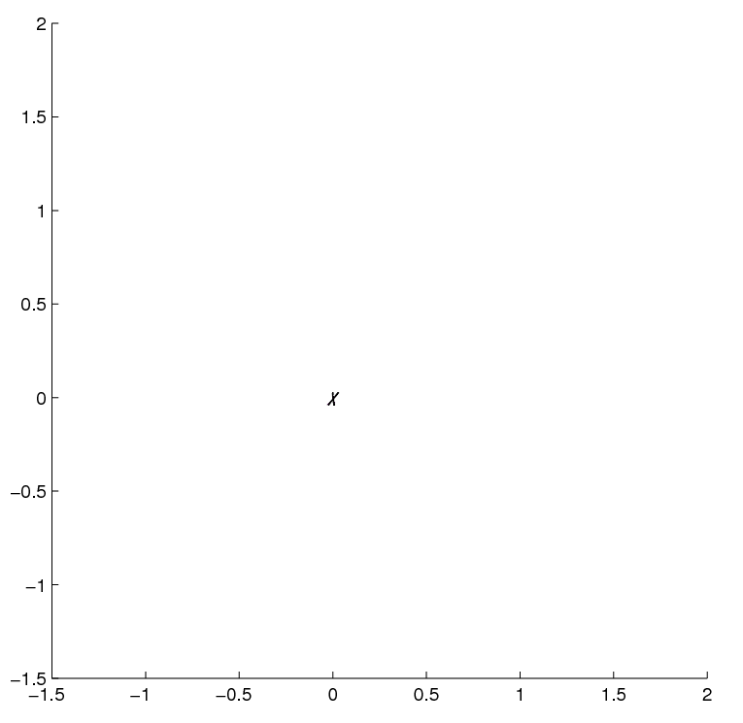
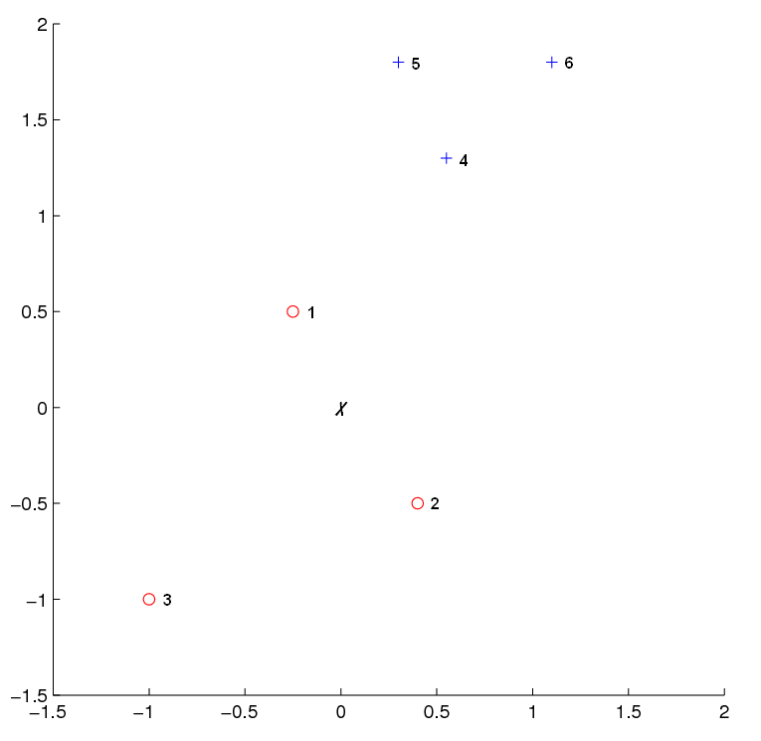
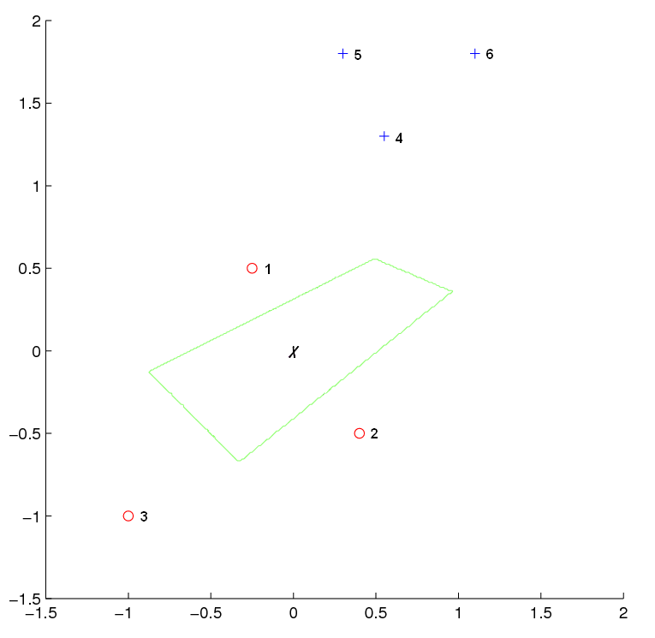
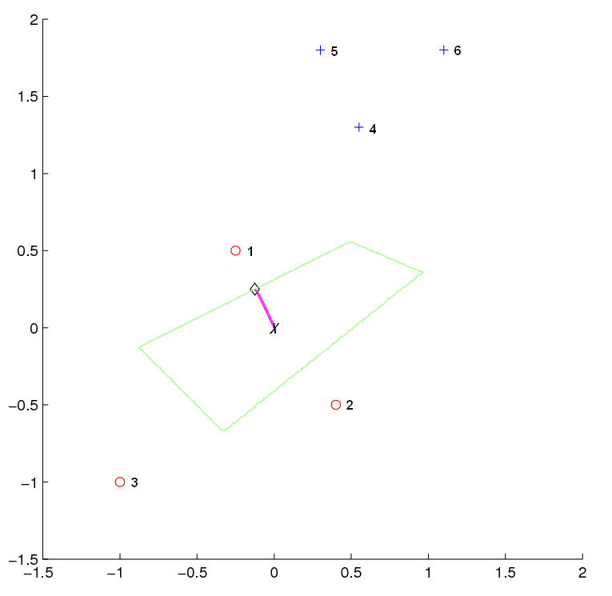
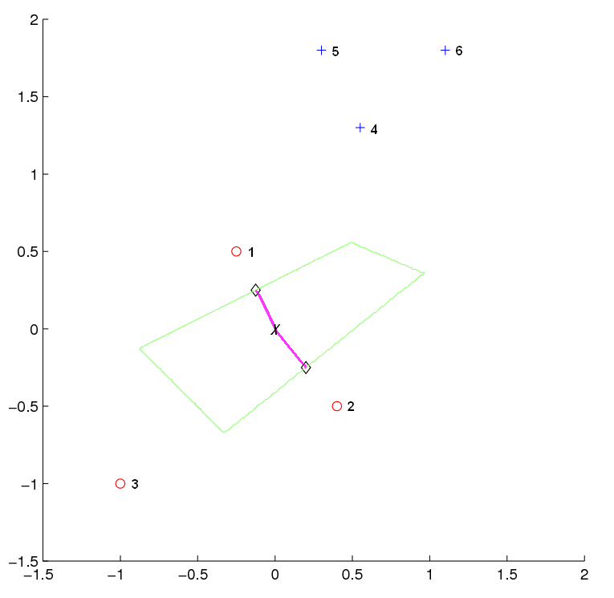
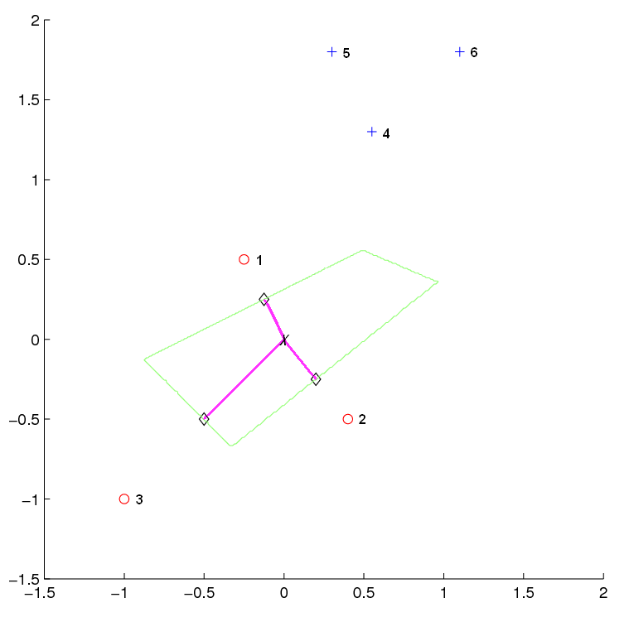
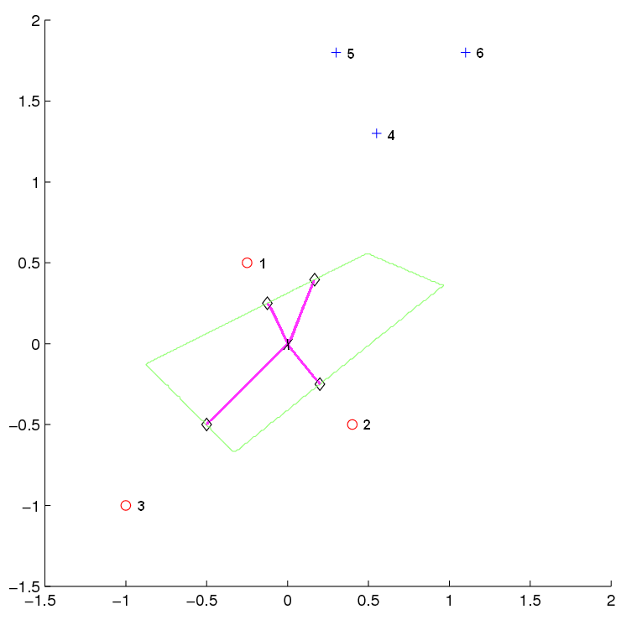
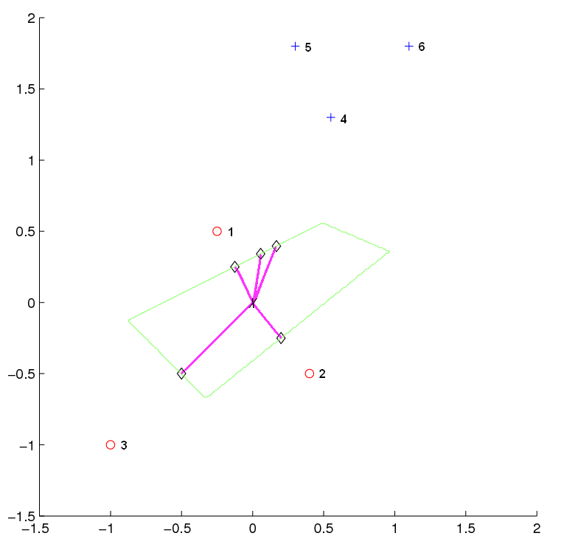
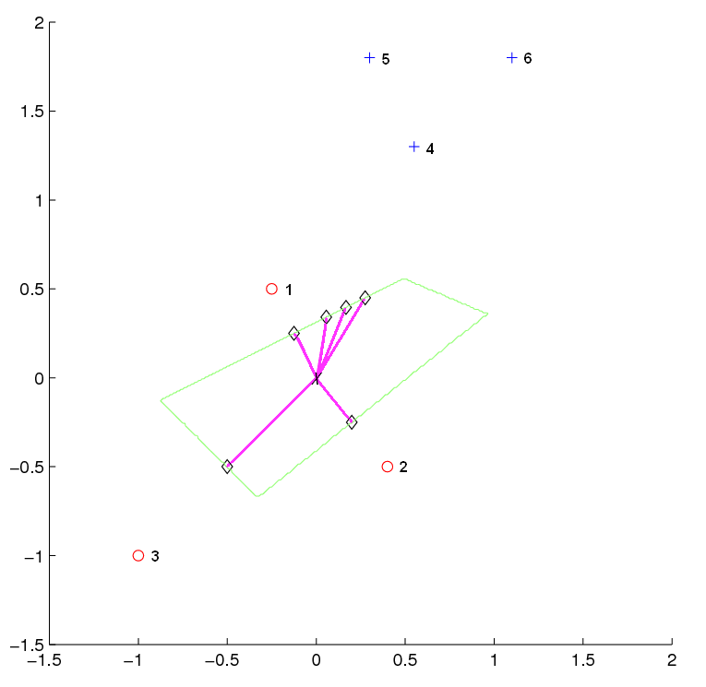
kNN-Based Local Variance
f(x’₄)
f(x’₆)
f(x’₅)
f(x’₁)
f(x)
f(x’₂)
f(x’₃)

Slide 12


What if we had a single base classifier?
Assume binary classification, {-1,+1}.
Base classifier estimates log-odds, , of belonging to the positive class.
Metaclassifier learns a weight vector w and makes a final prediction of the log-odds as a linear correction,
.
  Metaclassifier can only improve if base classifier is uncalibrated both in linear transform case and in general (DeGroot and Fienberg, Bayesian Inference and Decision Techniques, 1986).
  Platt recalibration is a special case of this.

Slide 13

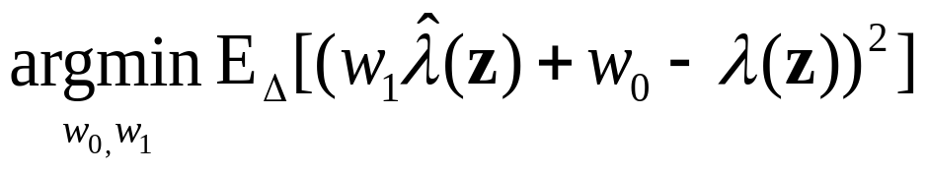
What about locally linear corrections?
What if metaclassifier learns weighting functions of the inputs W₀(x) and W₁(x) and then outputs,
?
Assuming we have a local distribution Δ_{x} = p(z|x) that gives probability of drawing a point z similar to x, we can recast this problem. For every x the metaclassifier uses the weight vector w by solving:

Slide 14

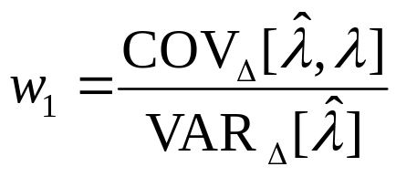
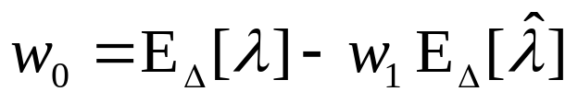

Motivation for Model-Based Indicators
Assume we know “true” log-odds, λ. Then, if
,
Obviously can’t compute terms involving “true” log-odds, but each classification model can specify a Δ and then compute terms like the sensitivity, .

Slide 15
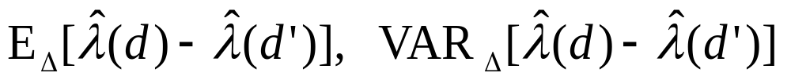
Model-Specific Reliability Indicators
For each model, define distribution Δ over documents similar to current document.
Compute:
kNN: randomly shift toward one of the k neighbors
Unigram: randomly delete a word.
naïve Bayes: randomly flip bit in entire vocabulary.
SVM: randomly shift toward support vectors.
Decision Tree: randomly shift toward nearby leaves.

Slide 16
Model-Specific Reliability Indicators (cont.)
Continued developing similar variables from related terms.
In total, the number of variables for each model:
  kNN: 10
  SVM: 5
  multivariate Bernoulli naïve Bayes (MBNB): 6
  multinomial naïve Bayes (NB): 6

Slide 17
Data Collection
744 e-mail messages collected at CMU that have been anonymized.
  http://www.cs.cmu.edu/˜pbennett/action-item-dataset.html
For this experiment, the messages were “hand-cleaned” by removing embedded previous messages, attachments, etc. Prevents chronological taints of cross-validation and needed for user-experiment token balancing.
Two people labeled all 744 messages.
  At the message level, 93% agreement. Kappa = 0.85
  At the sentence-level, 98% agreement. Kappa = 0.82.
    Kappa is a better indicator since labeling all 6301 sentences as “no action-item” would yield a high agreement.
  Resolved disputes to determine gold-standard (44% of messages contain action-items).

Slide 18

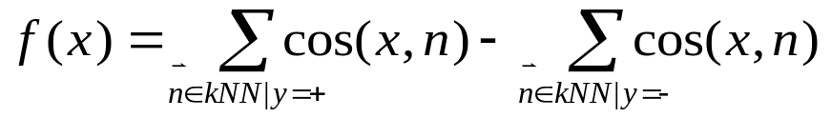
Base Classifiers
Dnet: Decision trees built with a Bayesian machine learning algorithm (i.e. dependency networks) using the WinMine Toolkit.
  Estimated log-odds at leaf nodes.
SVM: Linear Support Vector Machines built using SVMLight.
  Margin score.
Naïve Bayes: Also referred to as multivariate Bernoulli model in literature.
  Smoothed estimated log-odds.
Unigram: Also referred to as multinomial naïve Bayes Classifier in literature.
  Smoothed estimated log-odds
kNN: Distance-weighted voting with s-cut.

Slide 19
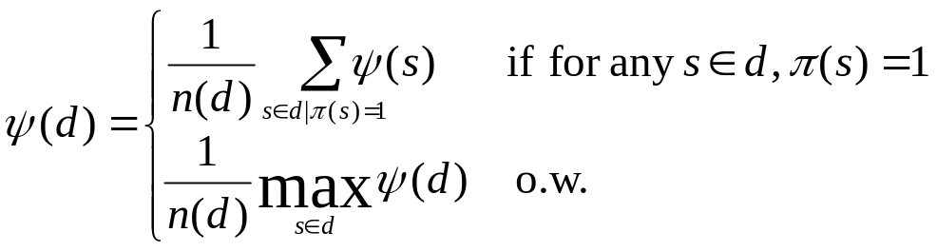
Obtaining Document Rankings from Sentence-Level Classifiers
Simple combination of scores for each sentence.
If any sentence was predicted positive, the score was the sum of all sentence scores above threshold else it was the max of the sentence scores.
The score was then normalized by the length of the document since longer documents (more sentences) give rise to more false positives.

Slide 20
Feature Representations
“Bag-of-Words”
  Alpha-numeric based bag-of-words representation
  Sentence-ending punctuation
“Ngram”
  Basic
  Sentence-ending punctuation
  N-grams
  Relative position of sentence in document (for sentence-level classifier)

Slide 21
Performance Measures
Ranking:
  Area Under the ROC Curve (AUC): equivalent to Mann-Whitney-Wilcoxon sum of ranks test (Hanley & McNeil, Radiology, 1982; Flach, ICML Tutorial, 2004).
    Probability that for a randomly chosen positive example, x+, and randomly chosen negative, x-, x+ will be ranked higher than x-, i.e. P(s(x+) > s(x-)).
RRA: relative residual area. (1 – AUC) / (1-AUC_{Baseline})
  bRRA – decrease over oracle-selected best base classifier AUC
  dRRA – decrease over oracle-selected dynamically best base classifier AUC per cross-validation run
F1: To ensure ranking improvement does not come at a cost of significant negative decrease.

Slide 22
Methodological Details
10-fold cross-validation
Top 300 features ranked by χ^{2.}
Two-tailed t-Test with p=0.05 to judge significance.

Slide 23
Metaclassifiers
20 base classifiers: 5 algorithms * 2 representations * 2 level views.
Stacking: linear SVM using just the base classifier outputs.
STRIVE: linear SVM using …
  Document-level: model-based RIVs (2*29=58).
    Sentence-level
      averaged model-based RIVs across sentence instances (2*29=58).
      Mean and deviation of confidence scores for sentences in a document. (2 * 2 * 5=20).
    Two voting-based RIVs (from Bennett et al., 2005).

Slide 24
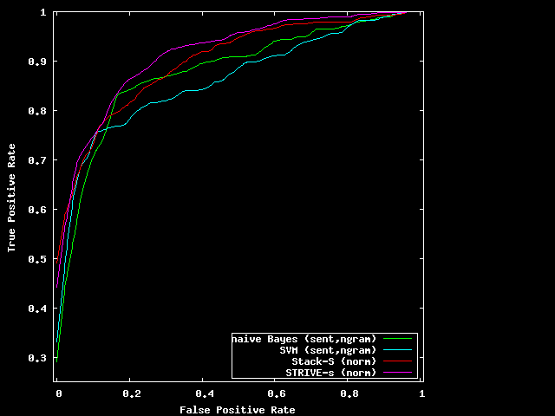
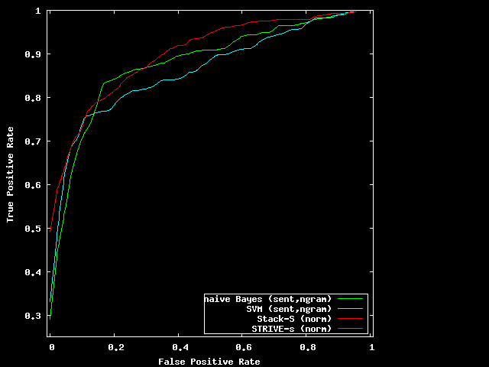
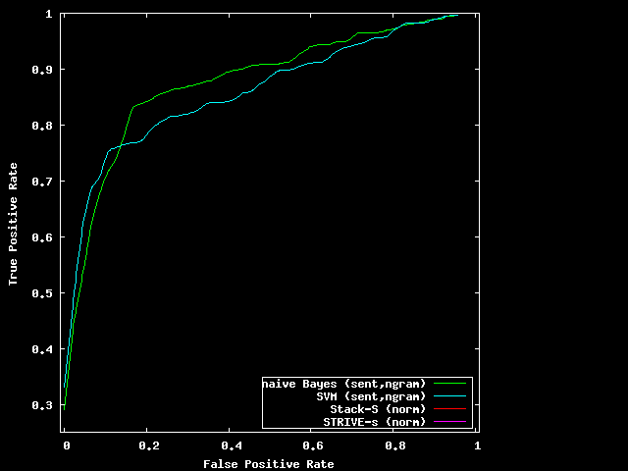
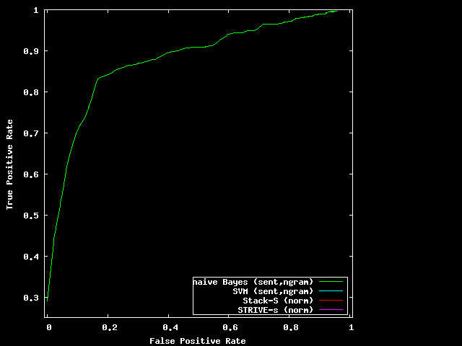
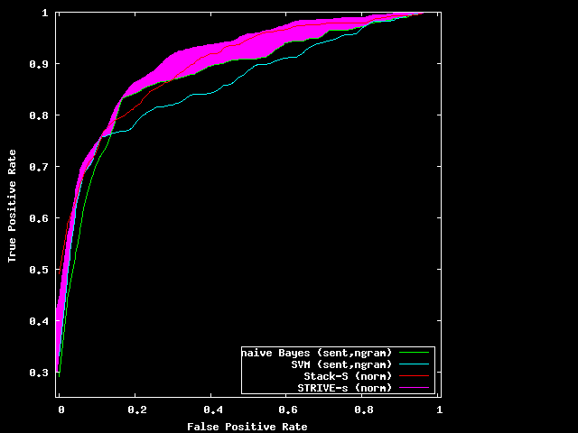
Action-Item Detection Ranking Performance

Slide 25
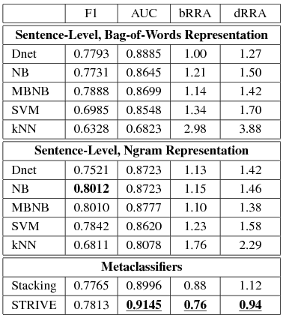
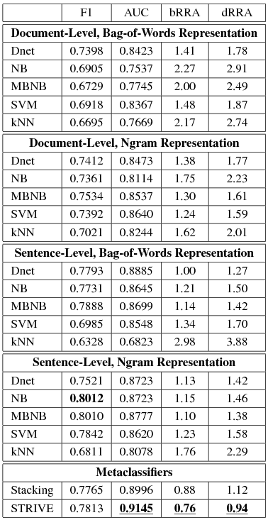
Combining Action-Item Detector Performance
24% improvement
over best base classifier!
6% improvement
over dynamically chosen
best base classifier.

Slide 26
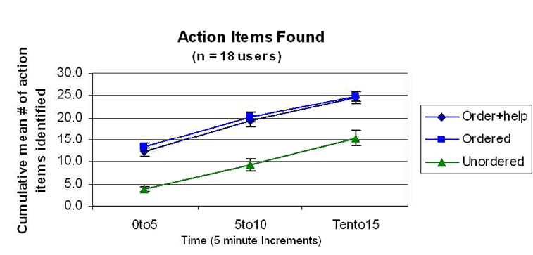
User Experiments
(Jill Lehman & Aaron Steinfeld)

Slide 27
Related Work on Action-Item Detection
Cohen et al. (EMNLP, 2004) looks at predicting an ontology of “speech acts” in e-mail.
  Action-Items can be seen as one type of (very important) speech act.
  Only worked with document-level judgments, we focus on both using and predicting at finer levels of granularity.
Corston-Oliver et al. (ACL-WS, 2004).
  Automatic construction of “to-do” list.
  Use fine-grained judgments but no study of impact (does the extra label collection effort really pay off in performance).
Bennett and Carbonell (SIGIR BBOW WS, 2005). Bennett (PhD Thesis, 2006).

Slide 28
Related Work on Classifier Combination
Bennett et al. (Information Retrieval, 2005). Bennett (PhD Thesis, 2006).
Kahn (PhD Thesis, 2004).
Lee et al. (ICML 2006).
Wolpert (Neural Networks, 1992).

Slide 29
Conclusions & Future Work
Formal motivation for reliability indicators.
Locality distributions to compute indicators related to common classification models.
Ranking performance improved by 24% relative to best base classifier.
Less variation in performance relative to the training set.
Use sensitivity estimates more directly as suggested by derivation (future work).

Slide 30
Action-Item Distribution
Num Action-Items | Num Messages
0 | 416 (56%)
1 | 259 (35%)
2 | 55 (7%)
3 | 11 (1%)
4 | 2 (1%)
5 | 0 (0%)
6 | 1 (1%)

Slide 31
Inter-Annotator Agreement
Annotator 1
Document-Level
  Kappa = 0.85
Sentence-Level
  Labeled positive when has ≥ 30% characters of an action-item
  Kappa = 0.82
 | No | Yes
No | 391 | 26
Yes | 29 | 298
Annotator 2
Annotator 1
 | No | Yes
No | 5810 | 65
Yes | 74 | 352
Annotator 2

Slide 32
Resolving Annotator Differences
Problems
  Annotator oversight
  Interpreting conditional statements
    If you would like to keep your job, come to tomorrow’s meeting.
    If you would like to join the football betting pool, come to tomorrow’s meeting.
After reconciling judgements
  416 messages with no action-items, 328 action-item messages
  Sentence-level agreement
    Annotator 1 Kappa = 0.89.
    Annotator 2 Kappa = 0.92.

Slide 33
What makes detection hard?
Language is mimicked in many other types of mail: spam, solicited advertisements, volunteer recruiting, etc.
Indirect speech acts
Conditional Statements
Context
  I’d like to take Friday off from work.
    In e-mail from secretary to boss
    vs. e-mail between friends.

